Slide 1
Part-Level Inventory & Excess Summary
March to June Comparison | LT UK

Slide 2
Total Financial Change Summary
Total Inventory Cost Change: £26,516,703.99
Total Excess Cost Change: £-464,128.52
Total Excess Qty Change: £-3,914.00
Total On Hand Change: £-9,119.00

Slide 3
Top Inventory Cost Increases
September COGS (): £4,011,246.64
Total per GL (): £3,769,923.89
Total from Aged WIP report (): £3,769,923.89
Total WIP (): £3,769,923.89
LT848768 (): £2,093,978.03
Customer (): £1,872,997.96
Internal (): £1,518,470.19
July COGS (): £1,275,512.08
LT850257 (): £782,389.79
LT850672 (): £712,663.00

Slide 4
Top Inventory Cost Decreases
TB5400-GG (): £-41,949.77
EEG-KIT (): £-40,339.87
RT33010/06 (): £-39,092.00
RT675-GG (): £-37,247.84
RT645-GG (): £-29,644.94
TB5000-GG (): £-28,746.84
TB35611C (): £-27,342.63
EEG-APM (): £-22,748.58
H246087A (): £-6,727.19
H246091A (): £-6,583.18

Slide 5
Top Excess Cost Increases
RM33026F (): £5,714.26
64/05011021/6 (): £3,972.71
RT13381B (): £3,239.54
RM23106 (): £1,905.75
H245323A (): £878.00
CT3009/101 (): £835.20
CT3009/119 (): £741.72
F245094A (): £674.60
H245313A (): £546.96
RT31385/3 (): £422.48

Slide 6
Top Excess Cost Decreases
H146016A (): £-81,017.02
RT33682 (): £-55,507.72
64/60070130/1 (): £-44,655.00
RM22304/01 (): £-38,892.19
RM22326C/01 (): £-22,400.08
RM33120/01 (): £-19,211.09
KIT-RT354016G (): £-17,334.48
64/51009008/2 (): £-14,648.09
64/51009011/2 (): £-14,095.68
KIT1-RM11200 (): £-12,634.65

Slide 7
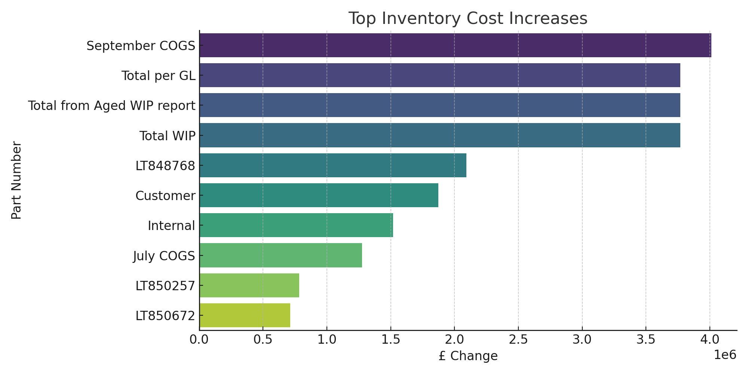
Top Inventory Cost Increases (Chart)

Slide 8
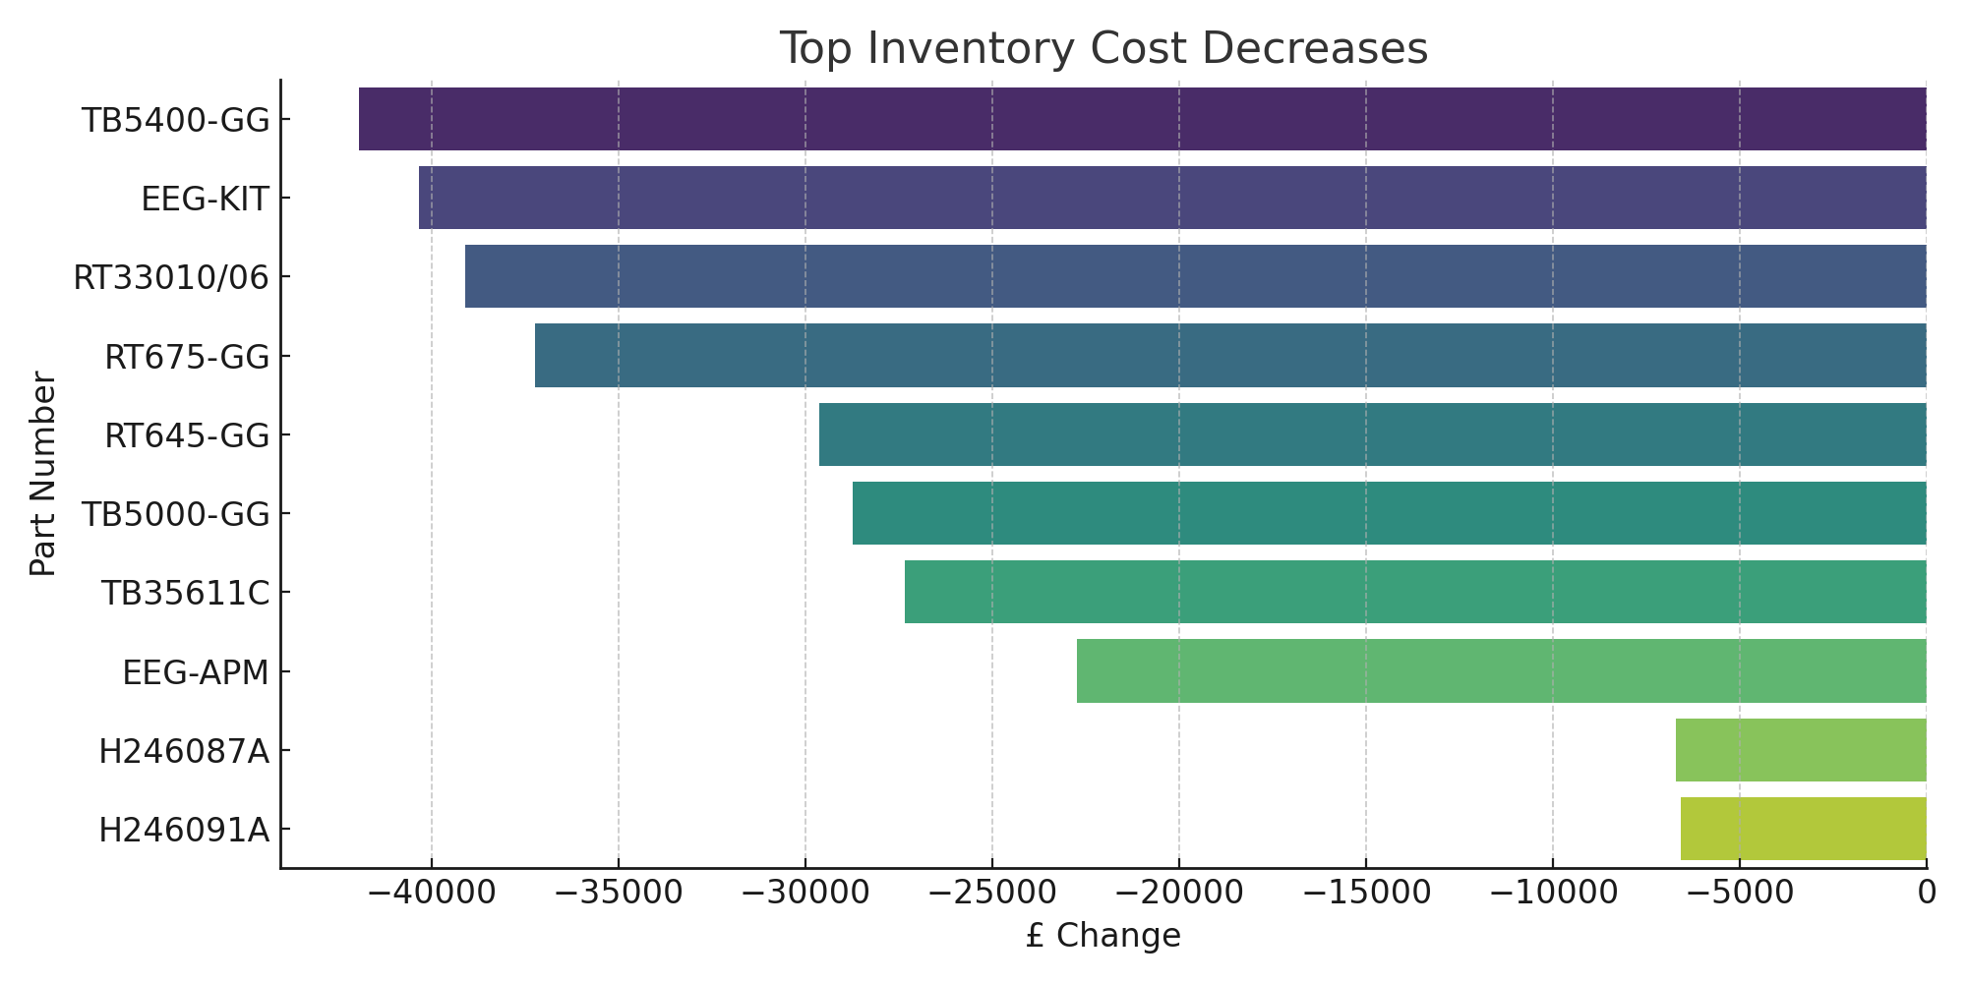
Top Inventory Cost Decreases (Chart)

Slide 9
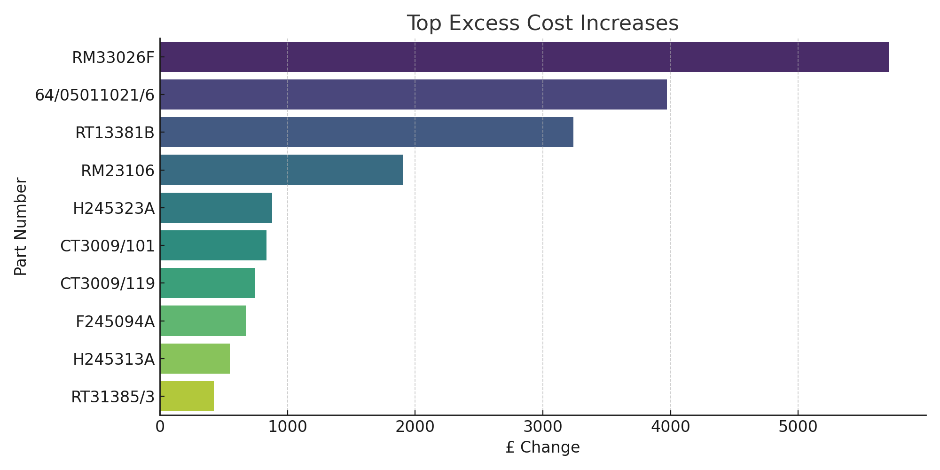
Top Excess Cost Increases (Chart)

Slide 10
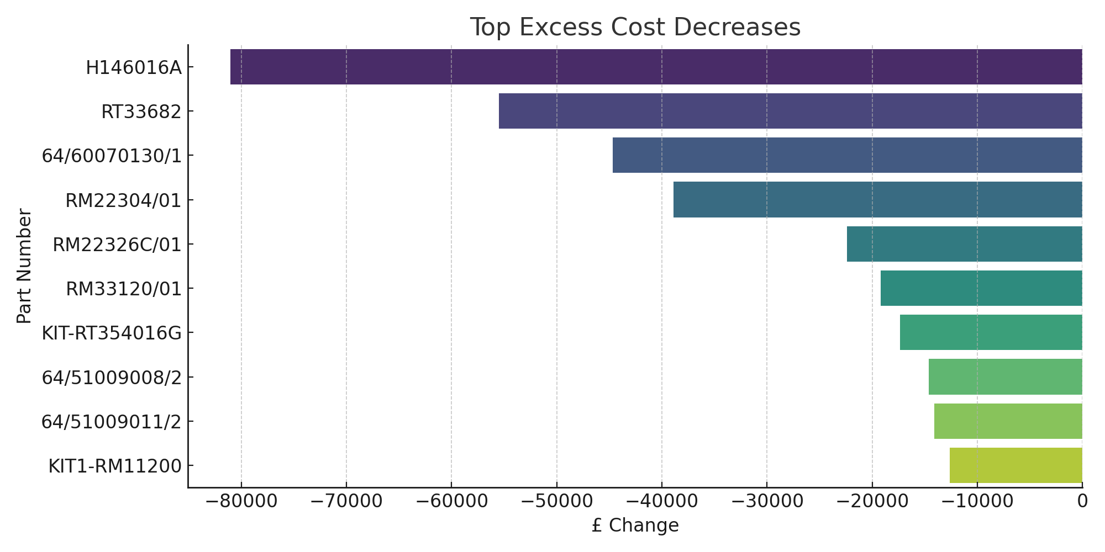
Top Excess Cost Decreases (Chart)

